Slide 1
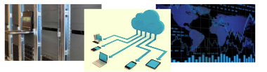
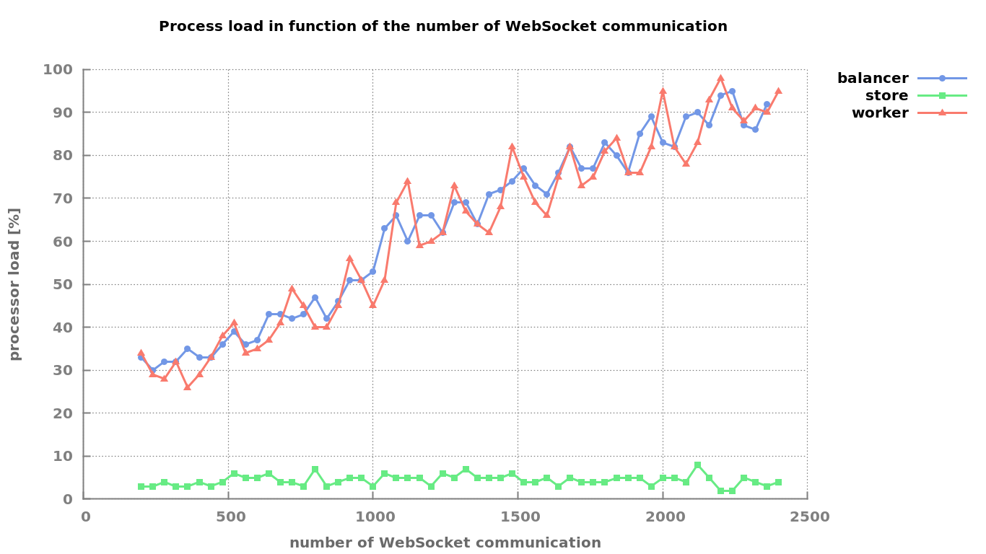
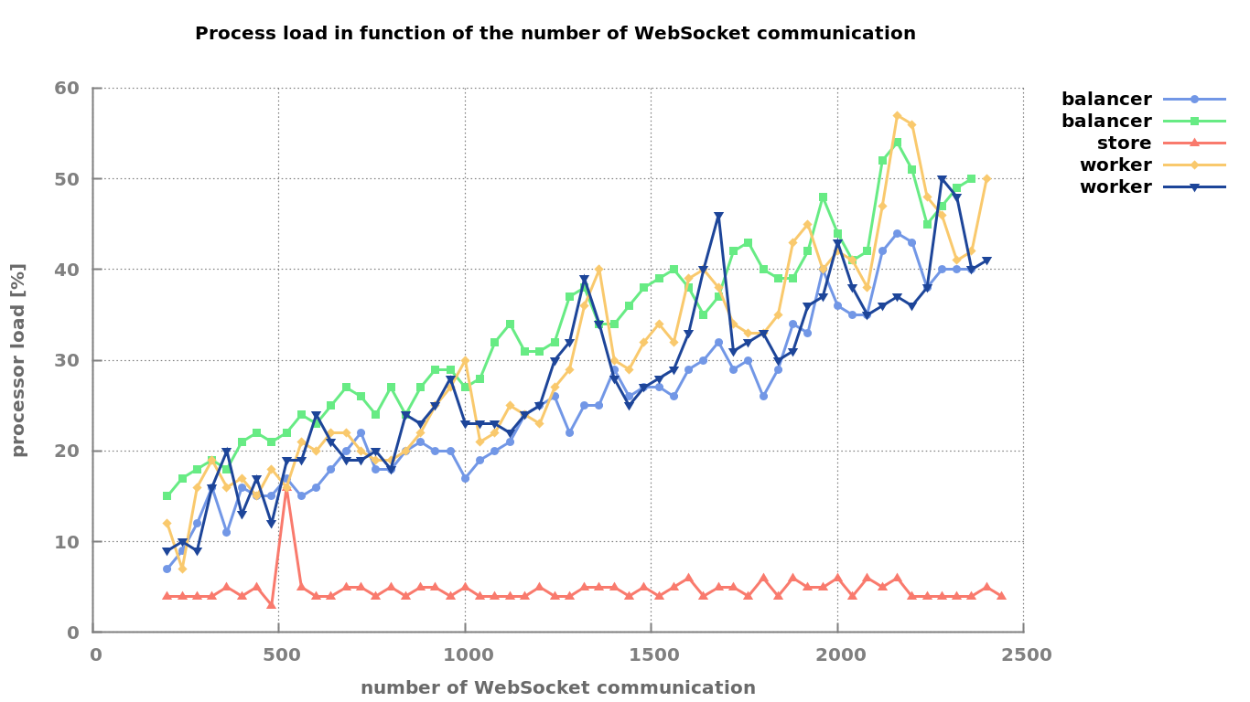
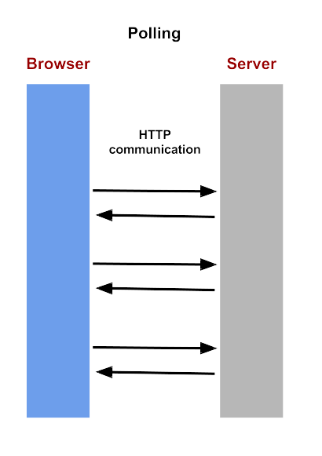
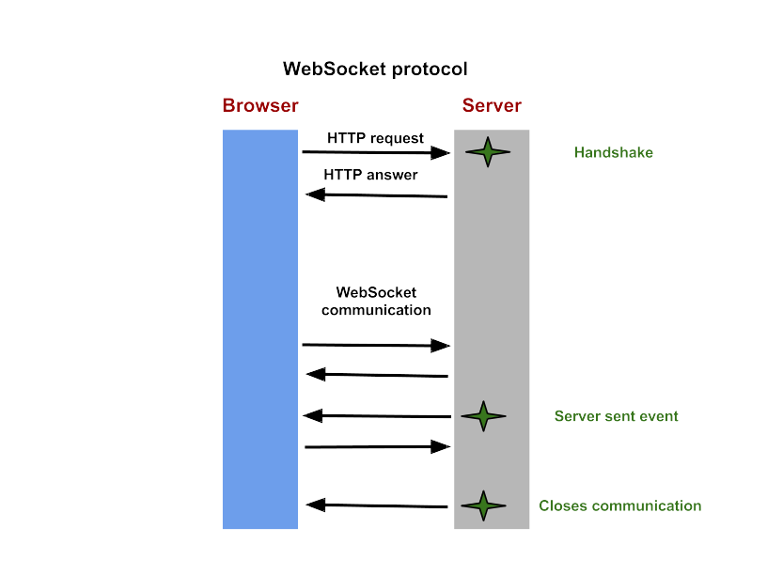

HTML5 WebSocket protocol and its application to distributed computing
Muller Gabriel
Supervisor: Dr. Mark Stillwell
School of Engineering
Cranfield University
Distributed Computing and e-Science group
Experiments
SocketCluster is based on engine.io. However, as opposed to engine.io it deploys itself as a cluster of processes in order to makes use of all cores on an instance.
There are three types of processes, load-balancer, stores and workers.
Motivation
HTML is the core language of the web. Daily new products are created to stay permanently connected to the web. WebSockets is the technology enabling this revolution.
As the web itself originally did, WebSockets enables entirely new kinds of applications.
Background
Until WebSockets were invented, client-server communication mainly used polling. WebSockets introduced two major upgrades to communications. Firstly they do not rely on HTTP, avoiding its overheads. Secondly it is a fully bidirectional protocol allowing server sent events.
In the first figure, worker and load-balancer cores have reached their maximum load.
This is not an issue for SocketCluster, new processes can be launched on additional cores. As can be inferred from the second figure, adding a worker and a load balancer drops the average load to about fifty percent.
Objectives
Conclusion
Node.js was invented to create real-times websites with server sent capabilities. Coupled together, WebSockets and Node.js provide powerful real-time engines.
However WebSockets are still an active field of research. Until recently there was no library to easily build a WebSocket cluster
SocketCluster is a highly scalable WebSocket server theoretically enabling unlimited vertical scaling. Benchmarking proved an application needs roughly the same number of load-balancers as workers.
Hence, N being the server's cores number, SocketCluster is at least N/2 times more efficient then a basic engine.io implementation.
making use of all cores available on a server.
SocketCluster is a new real-time engine aiming exactly at that.
MSc Computational and Software Techniques in Engineering 2014 | Distributed Computing & e-Science

